Slide 1





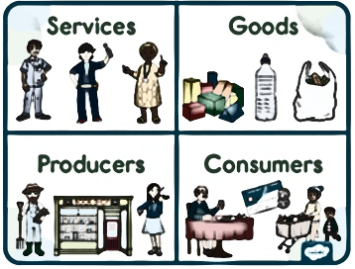
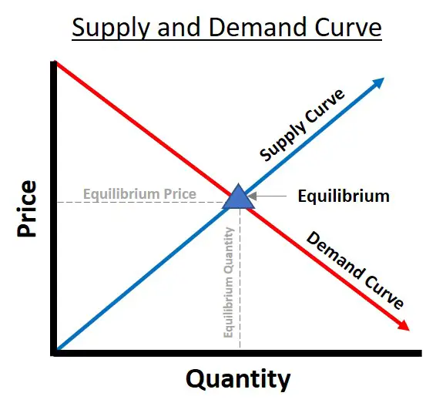

Scarcity
Scarce means limited. As resources in economics are often limited decisions must be made by economic agents on how they are used.
Demand
The quantity of a good or service that consumers are willing and able to buy at a given price and a given time period.
Supply
The amount of a product that firms are willing to produce and sell at a particular price during a specific time period.
When there is more of a resource available than is being consumed, we say that there is a surplus. Contrarily, a shortage occurs when market demand exceeds supply.
Scarcity arises when there's a mismatch between the supply and demand of a commodity; the demand surges, and the supply doesn't keep up. As a result, the commodity's price rises, which is termed scarcity pricing.
Monopoly
Where a single firm dominates the market. A firm is said to have a legal monopoly if it has more than 25% of the market share.
Competitive market
A market where a wide variety of producers are competing with each other to supply goods and services.
Within an economy, there are three main groups of agents.
- Producers.
- Consumers.
- Government.
An economic agent is an entity that engages in economic activity. This activity can be buying, selling, or producing goods and services
Economics is the study of how people make choices, while considering how these choices are constrained because of limited resources such as money, time, and information.
“The first lesson of economics is scarcity: There is never enough of anything to satisfy all those who want it.”
Unfortunately, monopolies can lead to…
Restricting output onto the market.
Charging a higher price than in a more competitive market.
Reducing consumer surplus and economic welfare.
Restricting choice for consumers.
Reducing consumer sovereignty.

