Slide 1

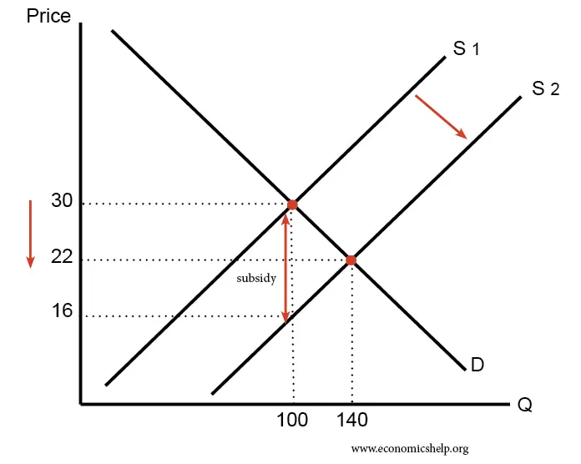

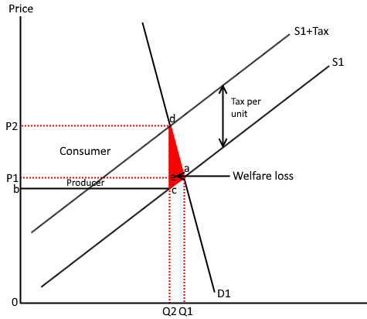



TAX
State owned
The government can nationailise the industry and control it. This is then said to be in the public sector.
The government will prioritise welfare and those that need it rather than to maximise profits.
The government could generate large economies of scale. However, the government is not usually efficient due to the lack of competition
The NHS is state owned and the railway tracks are too.
Historically, lots of utilities were in the public sector such as Electricity, Gas and Water.
Further reading: Read about what is happening to Thames Water and whether it should be nationalised.
Information
Information is one of the main causes of market failure: - ‘We don’t know how good are harmful some products are’ and therefore, we over consume or under consume.
Information campaigns by the government:
Cigarettes – All packaging is white and has clear messages of health impact of smoking.
Gambling – Some countries have banned the companies sponsoring football teams etc.
SUBSIDY
A subsidy means the government pays part of the cost. For example, the government may give farmers a subsidy of £10 for every kilo of potatoes. The effect is to shift the supply curve to the right, leading to lower price and higher quantity demanded
Regulation
The government could use laws to ban consumers from consuming a good. They
could also make it illegal not to do something. For example, the minimum school leaving age means young people have to be in school until the age of 16, and education or training until they turn 18.
Other forms of regulation include:
Direct taxation
Taxes based on income such as income tax or national insurance contributions.
Indirect taxation
Taxes on spending, examples of these would be excise duty and value added tax.
Taxes shift the supply curved to the left. This is because it increases the costs of production.
You can also see that it creates a loss of welfare – some people now have to go without the good.
The government generally place an indirect tax on products and services that we overconsume – to reduce our use.
Government
The organisation regulating consumers and producers.
Market failure
Where the market system fails to allocate resources efficiently.
Misallocation of resources
When there is an incorrect resource allocation to the creation of a good or service that results in welfare loss to society.
Government intervention
Laws on recycling
Bus lane usage
Working hours
Competitive behaviour
Quotas
Regulation can be expensive for the government to maintain and control. If they put rules in place, they need to create a way policing these.
Oppositely, regulation can force firms to pay fines if they do not conform to the rules.

