Slide 1
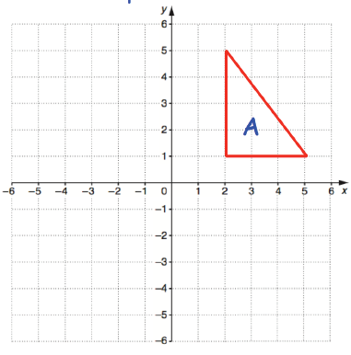
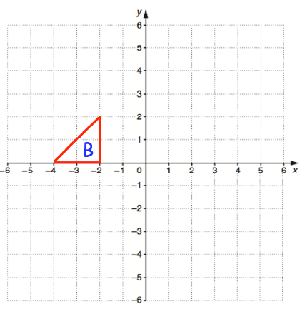
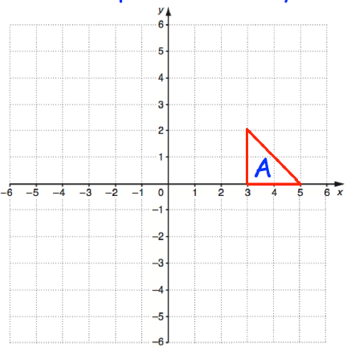

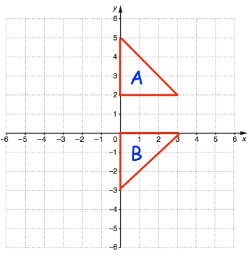
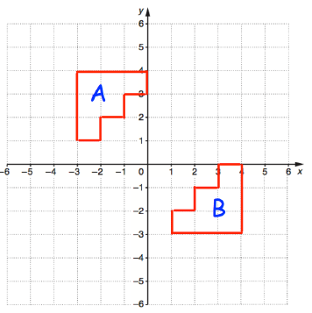
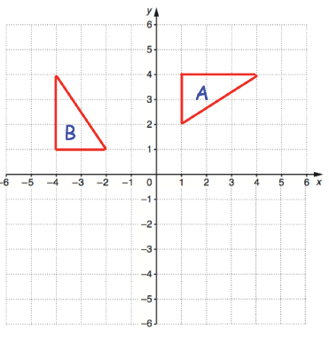
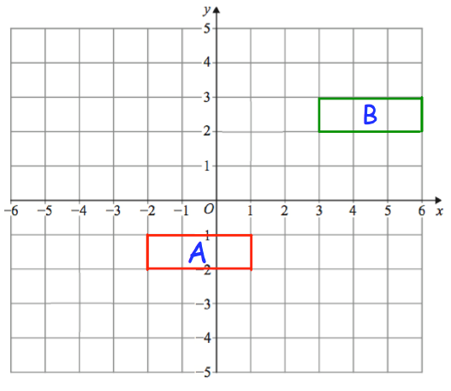







REFLECTION, ROTATION AND TRANSLATION
Key Concepts
Reflect shape A in the line $x=1.$ Label it B.
Examples
A reflection creates a mirror image of a shape on a coordinate graph. The mirror line is given by an equation eg. $y=2, x=2,y=x.$The shape does not change in size.
Rotate shape B from the point (-1, -2)
(-1,-2), clockwise, 90º. Label it C.
B
Reflect shape A in the line $y=x.$ Label it B.
Translate shape A by $\left({−3 \atop −2}\right)$. Label it B
A rotation turns a shape on a coordinate grid from a given point. The shape does not change size but does change orientation.
C
x
$$x=1$$
B
A translation moves a shape on a coordinate grid. Vectors are used to instruct the movement:
$$\left({x \atop y}\right)$$
B
Positive-Right
Negative - Left
Positive-Up
Negative - Down
$$y=x$$
Key Words
Rotate
Clockwise
Anticlockwise
Centre
Degrees
Reflect
Mirror image
Translate
Vector
Describe the single transformation you see on each coordinate grid from A to B:
637-641, 652, 653,654,648-650
ANSWERS: a) reflection, $y=1$ b) reflection$y=x$ c) rotation, centre (0,0), 90º anticlockwise
d) translation $\left({5 \atop 4}\right)$

Slide 2
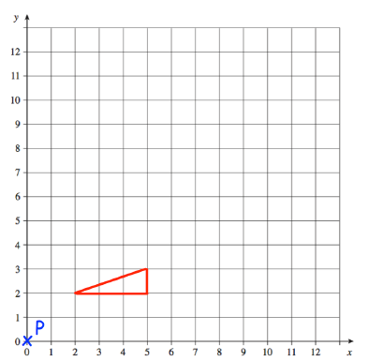
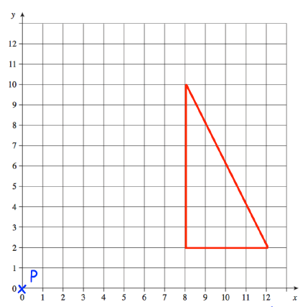
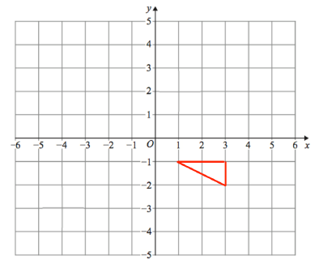
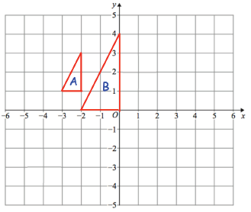
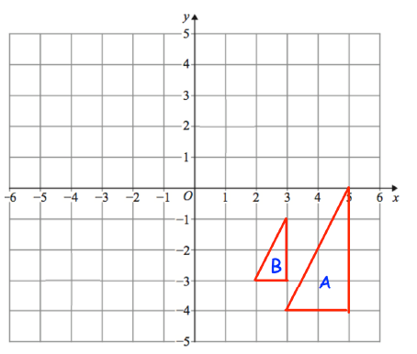
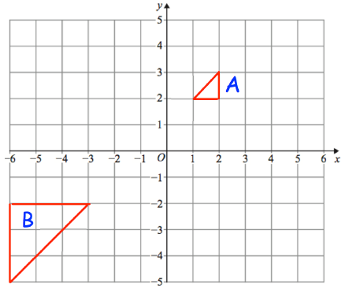
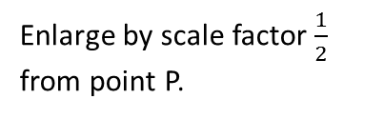
ENLARGEMENT
Key Concepts
Examples
An enlargement changes the size of an image using a scale factor from a given point.
A positive scale factor will increase the size of an image.
A fractional scale factor will reduce the size of an image.
A negative scale factor will place the image on the opposite side of the centre of enlargement, with the image inverted.
Enlarge shape A by scale factor 2 from point P.
Enlarge by scale factor $\frac{1}{2}$ from point P.
Enlarge by scale factor -2 from (0,0).
B
B
A
A
A
B
Key Words
Enlargement
Scale factor
Centre
Positive
Negative
Describe the single transformation you see on each coordinate grid from A to B:
637,638,650, 642-645, 651
ANSWERS: a) enlarge, centre (-4,2) scale factor 2 b) enlarge, centre (1,-2) scale factor $\frac{1}{2}$
c) enlarge, centre (0,1) scale factor -3

