Slide 1
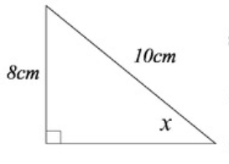
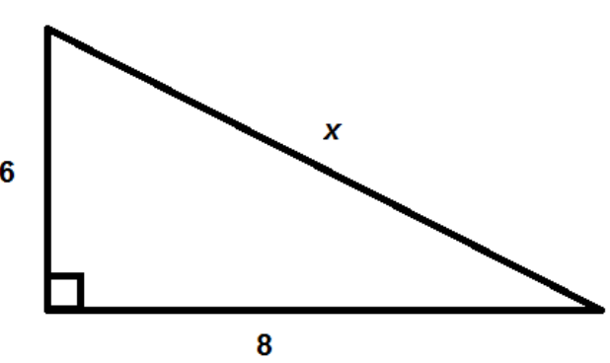
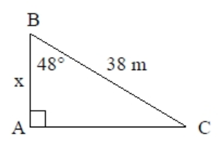
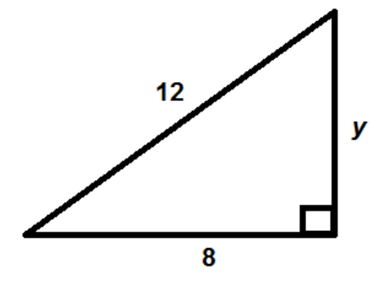

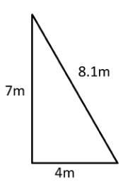
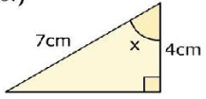
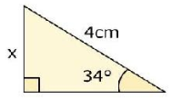
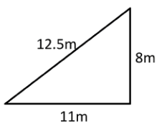





PYTHAGORAS AND TRIGONOMETRY
Key Concepts
Pythagoras’ theorem and basic trigonometry both work with right angled triangles.
Pythagoras’ Theorem – used to find a missing length when two sides are known
$$a^{2}+b^{2}=c^{2}$$
c is always the hypotenuse (the longest side)
Basic trigonometry SOHCAHTOA – used to find a missing side or an angle
When finding the missing angle we must press SHIFT on our calculators first.
Examples
Pythagoras’ Theorem
O
8
$$a^{2}+b^{2}=c^{2}$$
$$6^{2}+8^{2}=x^{2}$$
$100=x^{2}$
$\sqrt{100}=x$
$10=x$
H
S
H
Sinx
10
O
$$\sin{x}=\frac{8}{10}$$
$$x=\sin^{−1}\left(\frac{8}{10}\right)$$
$$x={53.1}^{o}$$
A
x
$$a^{2}+b^{2}=c^{2}$$
$$a^{2}+8^{2}={12}^{2}$$
$a^{2}={12}^{2}$-${ 8}^{2}$
$a^{2}=80$
$a=\sqrt{80}$
$a=8.9$
C
H
38
Cos48
O
A
O
$$\cos{48}=\frac{x}{38}$$
$$38×\cos{48}=x$$
$$x=25.4m$$
H
S
H
C
H
T
A
A
Key Words
Right angled triangle
Hypotenuse
Opposite
Adjacent
Sine
Cosine
Tangent
a) b) c) d)
Find the value of x.
x
498-499, 509-515
x
ANSWERS: a) 8.06m b) 5.94m c) 55.15º d) 2.34cm

