Slide 1
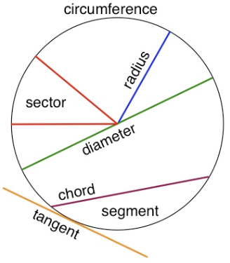
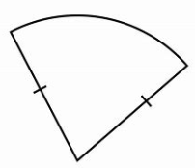
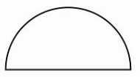
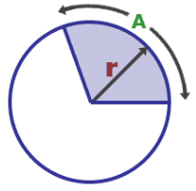



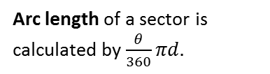


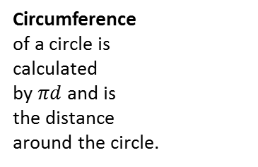

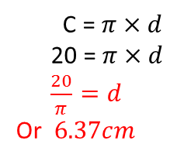
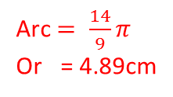
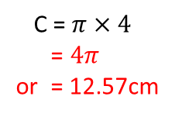
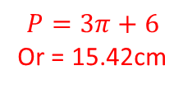
PERIMETER AND CIRCUMFERENCE
Key Concepts
Examples
Parts of a circle
Calculate:
a) Circumference
c) Perimeter
d) Arc length
Circumference
of a circle is
calculated
by $πd$ and is
the distance
around the circle.
C = $π×4$
= $4π$
or = 12.57cm
Arc $= \frac{θ}{360}×π×d$
28º
4cm
10cm
6cm
Arc $= \frac{28}{360}×π×2×10$
$$P= \frac{π×d}{2}+d$$
b) Diameter when the
circumference is 20cm
Arc $= \frac{28}{360}×π×20$
$$P= \frac{π×6}{2}+6$$
Arc length of a sector is calculated by $\frac{θ}{360}πd.$
C = $π×d$
20 = $π×d$
$\frac{20}{π}=d$
Or $6.37cm$
Arc $= \frac{14}{9}π$
Or = 4.89cm
$$P=3π+6$$
Or = 15.42cm
Key Words
Circle
Perimeter
Circumference
Radius
Diameter
Pi
Arc
Calculate:
The circumference of a circle with a diameter of 12cm
The diameter of a circle with a circumference of 30cm
The perimeter of a semicircle with diameter 15cm
The arc length of the diagram
534, 535, 537, 538, 541, 544-545
40º
8cm
ANSWERS: 1) $12π$ or 37.7cm 2) $\frac{30}{π}$ or 9.54cm 3) 38.56cm 4) $\frac{16}{9}π$ or 5.59cm

Slide 2
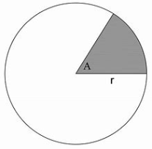


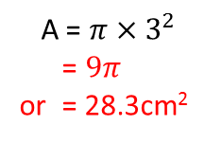

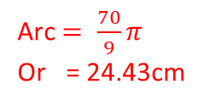

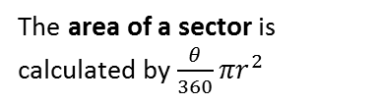





AREA OF CIRCLES AND PART CIRCLES
Key Concepts
Examples
Calculate:
The area of a circle is
calculated by $πr^{2}$
a) Area
c) Area
d) Area of a sector
A = $π×3^{2}$
= $9π$
or = 28.3cm²
Arc $= \frac{θ}{360}×π×r^{2}$
3cm
The area of a sector is calculated by $\frac{θ}{360}πr^{2}$
12cm
Arc $= \frac{28}{360}×π×{10}^{2}$
$$P= \frac{π×r^{2}}{2}$$
b) Radius when the
area is 20cm²
Arc $= \frac{28}{360}×π×100$
$$\sqrt{\frac{20}{π}}=r$$
Or $2.52cm$
$$P= \frac{π×6^{2}}{2}$$
A = $π×r^{2}$
20 = $π×r^{2}$
$\frac{20}{π}=r^{2}$
Arc $= \frac{70}{9}π$
Or = 24.43cm
$$P=18π$$
Or = 56.55cm²
28º
10cm
Key Words
Circle
Area
Radius
Diameter
Pi
Sector
Calculate:
The area of a circle with a radius of 9cm
The radius of a circle with an area of 45cm²
The area of a semicircle with diameter of 16cm
The area of the sector in the diagram
539, 540, 542-543, 546-547
40º
8cm
ANSWERS: 1) $81π$ or 254.47cm² 2) $\sqrt{\frac{45}{π}}$ or 3.78cm² 3) $32π$ or 100.53cm 4) $\frac{64}{9}π$ or 22.34cm

