Slide 1
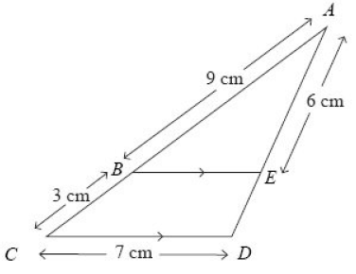

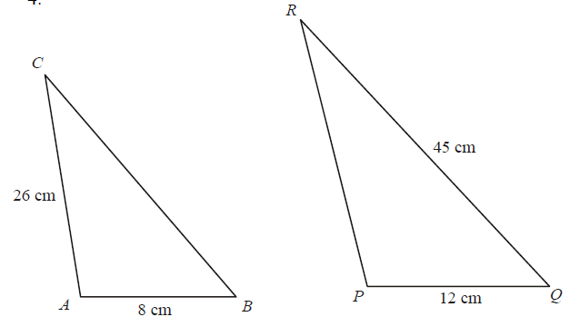
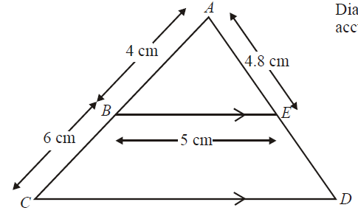



Year 10 Foundation
SIMILARITY - LENGTHS
Key Concepts
Examples
A
Similar shapes are an enlargement of one another.
A scale factor is used, whereby all lengths are multiplied by the same number.
When finding a missing length on the larger shape we multiply by the scale factor.
When finding a missing length on the smaller shape we divide by the scale factor.
11cm
9cm
y
6cm
2.5cm
10cm
A
B
y cm
E
3cm
Split the diagram
x
12cm
$$Scale factor=\frac{10}{2.5}$$
$=4$
6 + x cm
C
7cm
D
$$x=3×4$$
$=12cm$
× scale factor
$$Scale factor=\frac{12}{9}$$
$=\frac{4}{3}$
$$x+6=6×\frac{4}{3}$$
$x+6=8$
$x=8−6$
$x=2cm$
$$y=7÷\frac{4}{3}$$
$=5.25cm$
$$y=11÷4$$
$=2.75cm$
÷ scale factor
Key Words
Similar
Scale factor
Enlarge
Length
1) Calculate the length of:
PR
BC
2) Calculate the length of:
CD
ED
608-614
ANSWERS 1a) 39cm b) 30cm 2a) 12.5cm b) 7.2cm

Slide 2
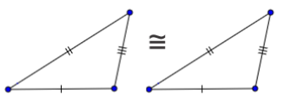
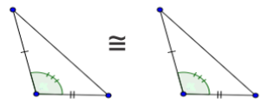
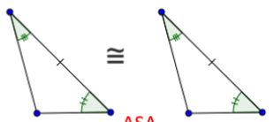
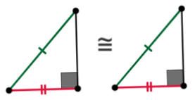
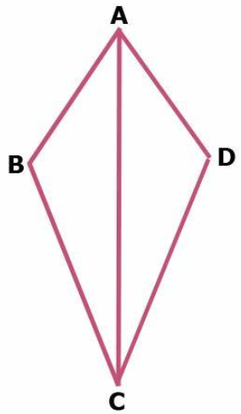
Year 10 Foundation
FOUR RULES OF CONGRUENCE
Key Concepts
Examples
Congruent triangles are triangles that have the same size and shape.
This means that the corresponding sides are equal and the corresponding angles are equal.
There are four rules of congruency that prove whether a triangle is congruent or not.
SSS = 3 sides on triangle A are equal to those on triangle B
SAS = 2 sides with the included angle on triangle A are equal to those on triangle B
ASA = 2 angles with the included side on triangle A are equal to those on triangle B
RHS = When the hypotenuse and another side on triangle A are equal to those on triangle B
Key Words
Congruent
Angle
Side
Prove that triangle ACD and ABC are congruent to one another.
680-682, 684-690
ANSWERS AD = AB, CD = BC, AC is common to both triangles, therefore they are congruent proved by the SSS rule.

