Slide 1
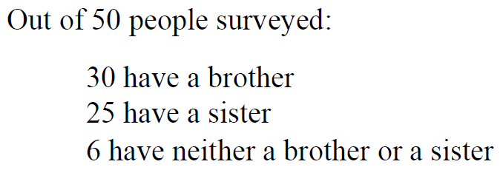

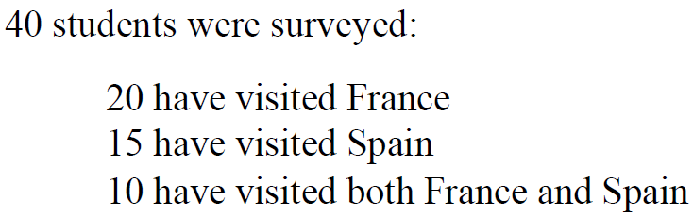


Year 10 Foundation
VENN DIAGRAMS
Key Concepts
Example
Venn diagrams show all possible relationships between different sets of data.
Probabilities can be derived from Venn diagrams. Specific notation is used for this:
P(A ∩ B) = Probability of A and B
P(A B) = Probability of A or B
P(A’) = Probability of not A
Complete the Venn diagram
Calculate:
i) P(A ∩ B) ii) P(A B) iii) P(B’)
$=\frac{8}{50}$ $=\frac{47}{50}$ $=\frac{20}{50}$
iv) The probability that a person with a sister, does not have a brother.
$$=\frac{8}{25}$$
8 have both a brother and sister
B
S
(30-8)
= 22
(25-8)
= 17
8
(50-22-8-17) = 3
Complete a Venn diagram to represent this information.
Calculate:
i) P(F ∩ S) ii) P(F S) iii) P(S’)
iv) The probability someone who has visited France, has not gone to Spain.
Key Words
Venn diagram
Union
Intersection
Probability
Outcomes
372-388, 391
ANSWERS: bi) 10/40 ii) 25/40 iii) 25/40 iv) 20/40 = 1/2

Slide 2
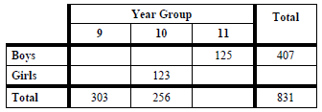
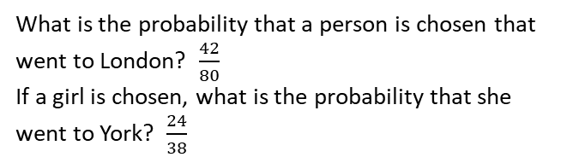


Year 10 Foundation
TWO WAY TABLES AND PROBABILITY TABLES
Key Concepts
Examples
There are only red counters, blue counters, white counters and black counters in a bag.
80 children went on a school trip. They went to London or to York.
23 boys and 19 girls went to London. 14 boys went to York.
Two way tables are used to tabulate a number of pieces of information.
Probabilities can be formulated easily from two way tables.
Probabilities can be written as a fraction, decimal or a percentage however we often work with fractions. You do not need to simplify your fractions in probabilities.
Estimating the number of times an event will occur
Probability × no. of trials
Colour | Red | Blue | Black | White
No. of counters | 9 | 3x | x-5 | 2x
A counter is chosen at random, the probability it is red is $\frac{9}{100}.$ Work out the probability is black.
 | London | York | Total
Girls | 19 | 24 | 43
Boys | 23 | 14 | 37
Total | 42 | 38 | 80
$$9+3x+x−5+2x=100$$
$6x+4=100$
$x=16$
Number of black counters = 16 – 5
= 11
Probability of choosing black = $\frac{11}{100}$
What is the probability that a person is chosen that went to London? $\frac{42}{80}$
If a girl is chosen, what is the probability that she went to York? $\frac{24}{38}$
Key Words
Two way table
Probability
Fraction
Outcomes
Frequency
2a) Complete the two way table:
 | 1 | 2 | 3
Prob | 0.37 | 2x | x
353, 422-424
1a) Calculate the probability of choosing a 2 or a 3.
b) Estimate the number of times a 2 will be chosen if the experiment is repeated 300 times.
b) What is the probability that a Y10 is chosen, given that they are a girl .
ANSWERS: 1) a) P(2) = 0.42 P(3) = 0.21 b) 0.42×300=126 2b) 123/424

