Slide 1
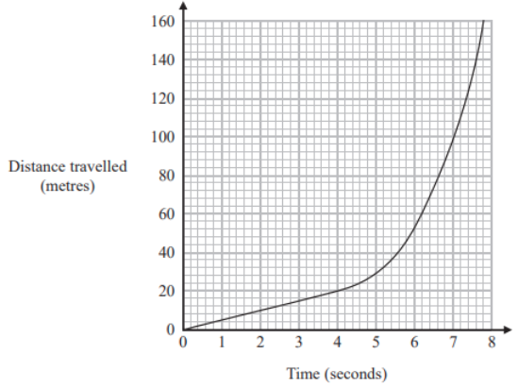

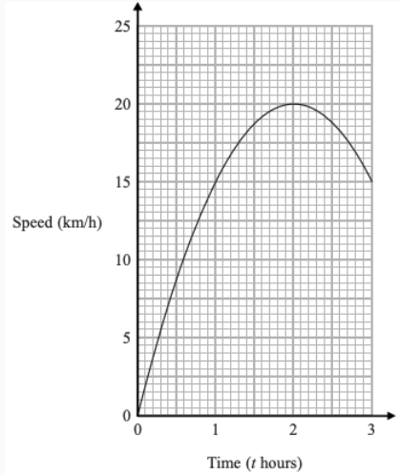

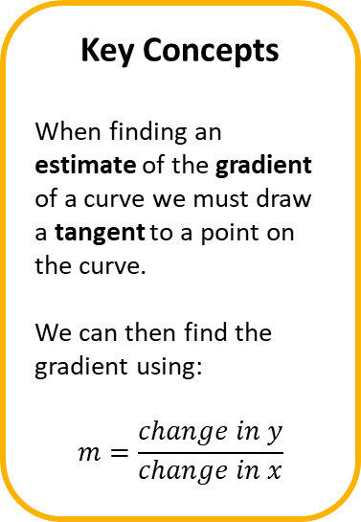
Year 10 Higher
TANGENT FROM A NON LINEAR GRAPH
Key Concepts
When finding an estimate of the gradient of a curve we must draw a tangent to a point on the curve.
We can then find the gradient using:
$$m=\frac{change in y}{change in x}$$
Examples
The distance-time graph shows information about part of a car journey.
Use the graph to estimate the speed of the car at the time of 5 seconds.
Draw a tangent at the point (5, 28) – make sure you use a ruler and a sharp pencil!
$$m=\frac{40}{3}=13.3m/s$$
tangent
40
3
Key Words
Tangent
Gradient
Rate of change
Estimate
The graph gives the speed, in km/h, of a ship t hours after leaving a port.
Find an estimate of the gradient of the graph
when t = 1.3
319
ANSWERS: $m≈6$

Slide 2
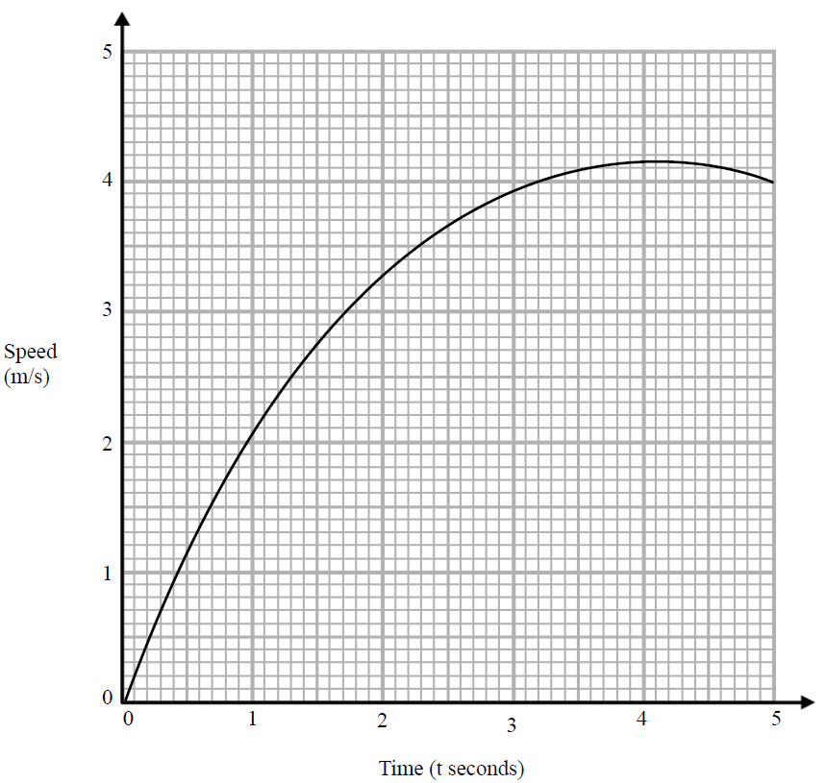
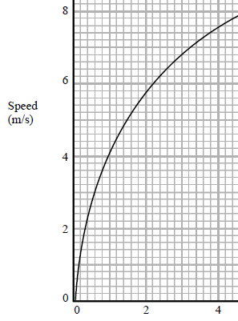

Year 10 Higher
AREA UNDER A GRAPH
Key Concepts
Examples
A velocity-time graph (or speed-time graph) is a way of visually expressing a journey. With speed or velocity on the y-axis and time on the x-axis.
A velocity-time graph tells us how someone's speed has changed over a period of time.
The distance completed in the journey can be calculated from the area underneath the curve.
Use 3 strips of equal width to find an estimate of the distance travelled in the first 3 seconds.
The strips will either be triangles or trapeziums. You will calculate the area of each section separately and combine the answers for the complete distance.
$$\left(\frac{1×2}{2}\right)+\left(\frac{(2+3.2)×1}{2}\right)+\left(\frac{(3.2+3.9)×1}{2}\right)$$
$$=7.15m$$
Velocity
Key Words
Velocity
Speed
Distance
Area
Trapezium
Use 2 strips of equal width to find an estimate of the distance travelled in the first 4 seconds.
891 - 893
ANSWERS: 19.2m

