Slide 1
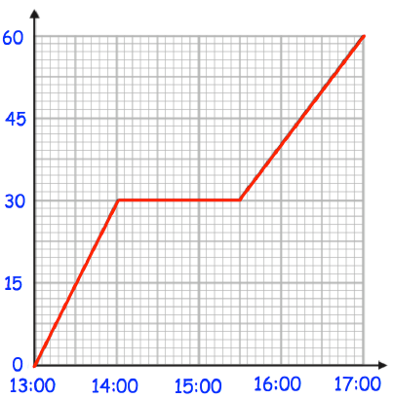
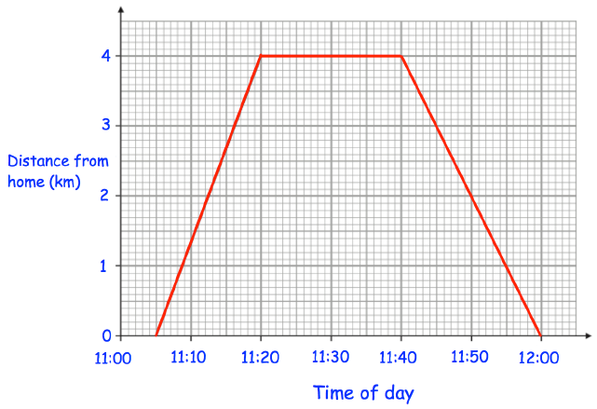

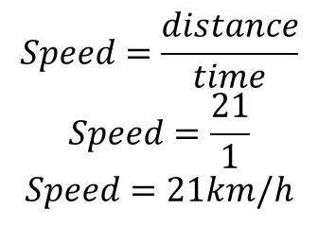
Year 9 Higher
DISTANCE-TIME GRAPHS
Key Concepts
Examples
Horizontal sections are
where the object is
stationary
D
21
A distance-time graph, plots time against the distance away from a starting point.
Speed can be calculated from these graphs by finding the gradient of the graph.
Horizontal lines are sections where the object is stationary.
S
T
1
S
$$Speed=\frac{distance}{time}$$
$$Speed=\frac{21}{1}$$
$$Speed=21km/h$$
21km
Distance in
Km from home
Diagonal lines show the object moving away from home or moving closer to home
1hr
Time
Key Words
Distance
Time
Speed
Gradient
Stationary
A distance-time graph shows the journey of someone from home to the shop and back again.
How long were they at the shop for?
How far away from home is the shop?
How far did they travel in total?
What speed did they travel on the way to the shop in km/h?
874 - 879
ANSWERS: 1) 20 minutes 2) 4km 3) 8km 4) 16km/h

Slide 2
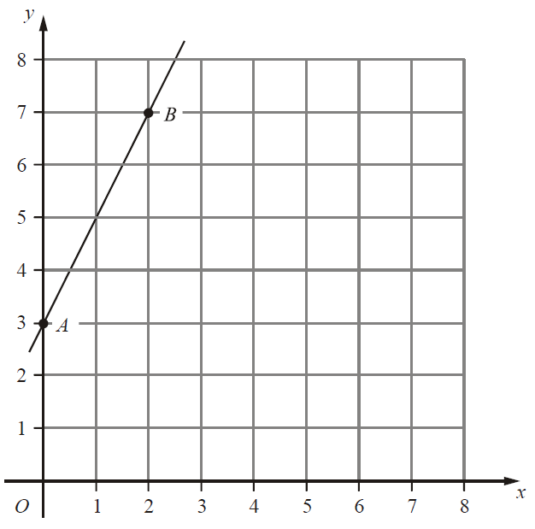
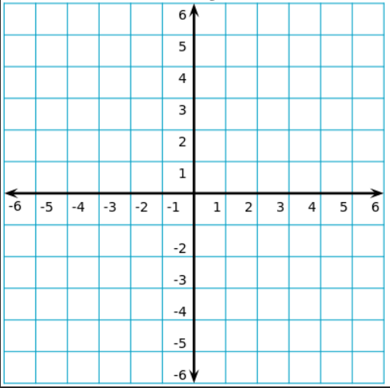
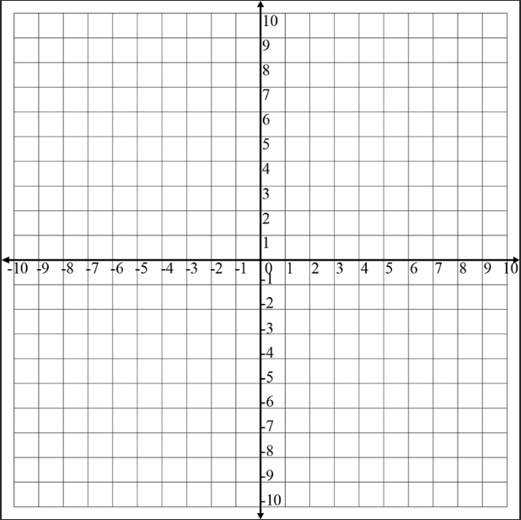
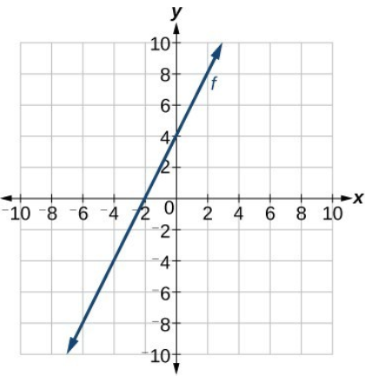





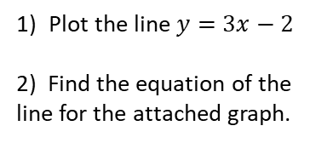




Year 9 Higher
STRAIGHT LINE GRAPHS AND EQUATION OF A LINE
Key Concepts
Plot the graph of $y=x+1$
Examples
x | 0 | 1 | 2
y | 1 | 2 | 3
Calculate the equation of this line:
Coordinates in 2D are written as follows:
$$\left(x,y\right)$$
$$y=mx+c$$
y
$$m=\frac{4}{2}$$
$=2$
x is the value that is to the left/right
y is the value that is to up/down
x
Straight line graphs always have the equation:
$$y=mx+c$$
m is the gradient i.e. the steepness of the graph.
c is the y intercept i.e. where the graph cuts the y axis.
x
4
$$y=2x+c$$
x
x
Substitute in a coordinate: (2,7)
2
$$7=(2×2)+c$$
$$3=c$$
$$y=2x+3$$
Key Words
Coordinate
Gradient
Plot the line $y=3x−2$
2) Find the equation of the line for the attached graph.
199,200,205,207-211,214
ANSWERS: 2) $y=2x+4$

Slide 3
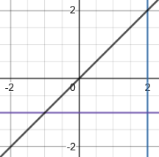
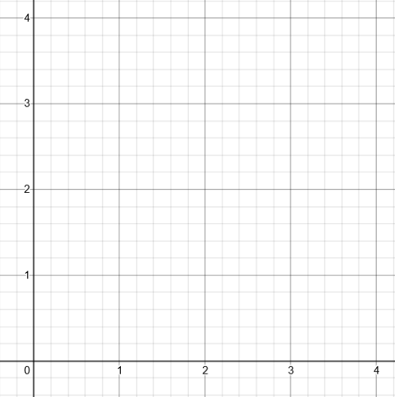

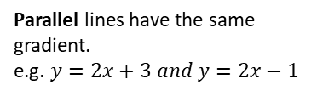

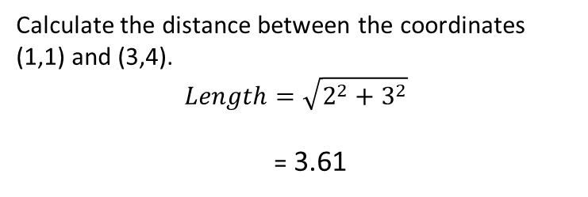


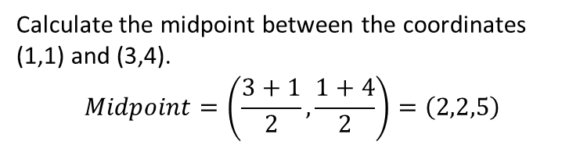
Year 9 Higher
COORDINATE GEOMETRY
Key Concepts
Examples
$$y=x$$
x
Calculate the midpoint between the coordinates (1,1) and (3,4).
$$Midpoint=\left(\frac{3+1}{2},\frac{1+4}{2}\right)=\left(2,2,5\right)$$
3
$$y=−1$$
$$x=2$$
x
Calculate the distance between the coordinates (1,1) and (3,4).
$$Length=\sqrt{2^{2}+3^{2}}$$
= 3.61
Parallel lines have the same gradient.
e.g. $y=2x+3 and y=2x−1$
2
Perpendicular line gradients are the negative reciprocal of one another
e.g. $y=2x and y=−\frac{1}{2}x$
Key Words
Parallel
Perpendicular
Gradient
Midpoint
Length
Calculate the midpoint between the coordinates (2,7) and (9,11).
Calculate the distance between the coordinates (2,7) and (9,11).
200, 205, 208
ANSWERS: 1) (5.5, 9) 2) 8.06

Slide 4
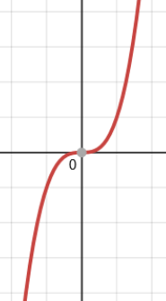
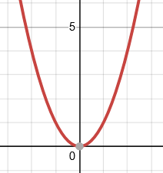
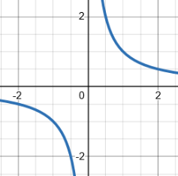
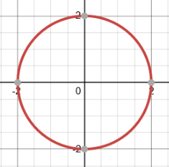
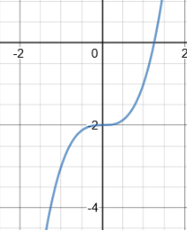
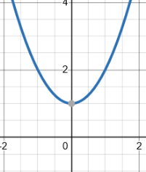
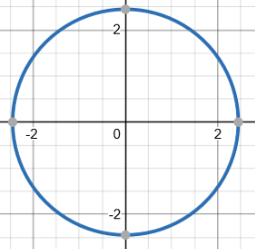

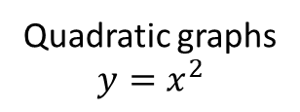

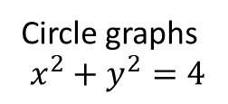

Year 9 Higher
TYPES OF GRAPH
Examples
Quadratic graphs
$$y=x^{2}$$
Reciprocal graphs
$$y=\frac{1}{x}$$
Circle graphs
$$x^{2}+y^{2}=4$$
Cubic graphs
$$y=x^{3}$$
Key Words
Quadratic
Cubic
Reciprocal
Circle
Graph
Match the graph with the correct equation:
$x^{2}+y^{2}=6$
$y=\frac{1}{x}$
$y=x^{3}−2$
$y=x^{2}+1$
b)
d)
257, 298-301, 314
a)
c)
ANSWERS: 1d 2b 3a 4c

Slide 5
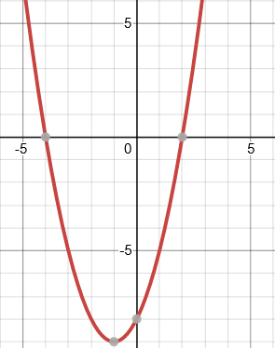
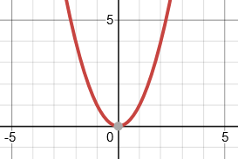
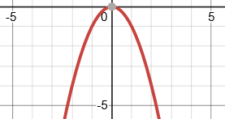
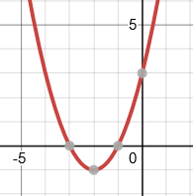








Year 9 Higher
QUADRATIC GRAPHS
Key Concepts
Line of symmetry
$$x=−1$$
Examples
A quadratic graph will always be in the shape of a parabola.
$$y=x^{2}+2x−8$$
$$y=x^{2}$$
$$y={−x}^{2}$$
A quadratic equation can be solved from its graph.
The roots of the graph tell us the possible solutions for the equation. There can be 1 root, 2 roots or no roots for a quadratic equation. This is dependant on how many times the graph crosses the x axis.
The roots of a quadratic graph are where the graph crosses the x axis. The roots are the solutions to the equation.
Roots $x=−4$
$x=2$
Turning point
$$(−1,−9)$$
y intercept = $−8$
Key Words
Quadratic
Roots
Intercept
Turning point
Line of symmetry
Identify from the graph of $y=x^{2}+4x+3$:
The line of symmetry
The turning point
The y intercept
The two roots of the equation
251-256
ANSWERS 1) $x=−2 2) (−2,−1) 3) 3 4) x=−1 and x=−3$

Slide 6
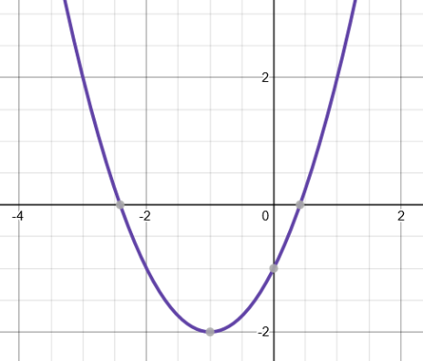
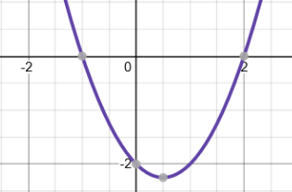
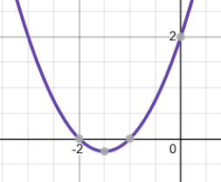






Year 9 Higher
SOLVE QUADRATIC INEQUALITIES GRAPHICALLY
Key Concepts
Examples
When an quadratic inequality is solved it provides the range of values that are possible.
When an equation has solutions greater than 0 then the solutions are taken from above the x axis.
When an equation has solutions less than 0 then the solutions are taken from below the x axis.
$$x^{2}+2x−1≥0$$
$$x^{2}+2x−1≤0$$
The range of solutions are:
The range of solutions are:
$$x≥0.5 and x≤−2.5$$
$$−2.5≤x≤0.5$$
1)
2)
Key Words
Quadratic
Inequality
Solutions
State the range of values possible for each inequality.
277
$$x^{2}−x−2≥0$$
$$x^{2}+3x+2≤0$$
ANSWERS 1) $x≤−1 and x≥2$2) $−2≤x≤−1$

Slide 7
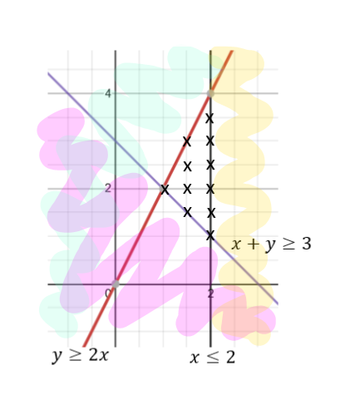
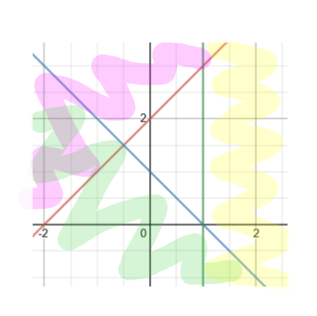





Year 9 Higher
INEQUALITIES AND REGIONS ON GRAPHS
Key Concepts
Examples
Inequalities can be represented on graphs. They highlight regions where all of the possible true values exist within its given constraints.
Solid lines are used on the graph when ≤ ≥ are involved.
Dashed lines are used on the graph when $<>$ are involved.
Highlight the region that represents the possible solutions to the following inequalities:
$$x≤2$$
$$y≤2x$$
$$x+y≥3$$
Plot the points for each linear graph and draw the lines.
Choose a coordinate whose values can be substituted in to each inequality. If the inequality is FALSE once values have been substituted in, then shade this area.
You should be left with one area with no shading once you have repeated this for all inequalities.
Each x is a possible set of integer values which are true for all three inequalities. Eg. (2,1), (2,2) (2,3)…
$$y ≤x+2$$
State the possible integer values that are true for the given inequalities.
Key Words
Region
Inequality
Solution
273-276
$$x≤1$$
$$y≥−x+1$$
ANSWER (1,0), (1,1), (1,2), (1,3), (0,1), (0,2)

