Slide 1
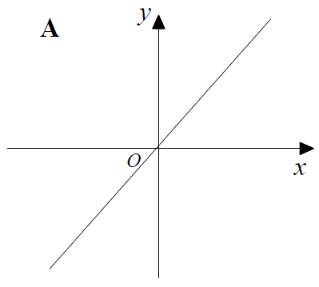
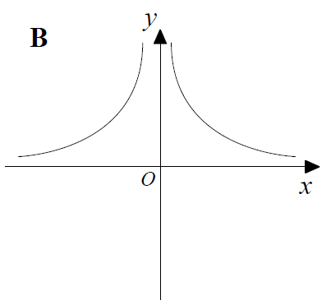
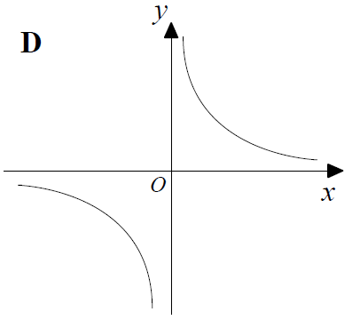
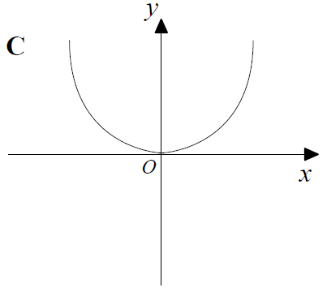

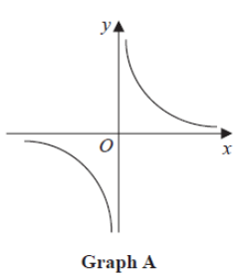
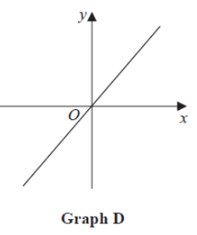
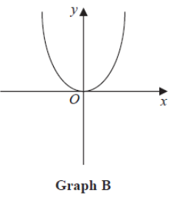
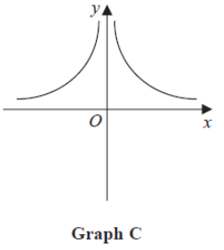
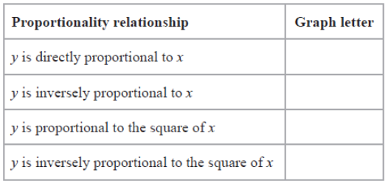




Year 10 Higher
DIRECT AND INVERSE PROPORTION ON GRAPHS
Key Concepts
Examples
Variables are directly proportional when the ratio is constant between the quantities.
Variables are inversely proportional when one quantity increases in proportion to the other decreasing.
Direct and inverse proportion can also be represented on graphs.
$$y∝\frac{1}{x}$$
$$y∝x$$
y is directly proportional to x
y is inversely proportional to x
$$y∝\frac{1}{x^{2}}$$
$$y∝x^{2}$$
y is directly proportional to x²
y is inversely proportional to x²
Match the correct graph to each statement:
Key Words
Direct
Inverse
Proportion
Graph
340, 348
ANSWERS

Slide 2
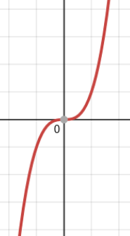
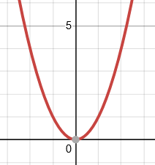
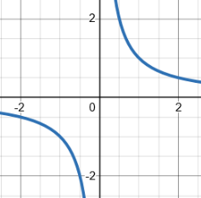
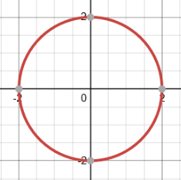
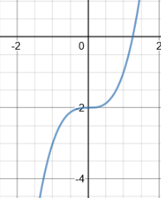
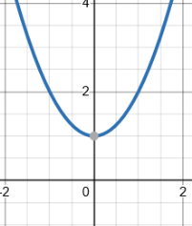
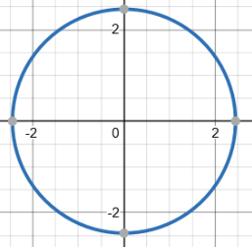

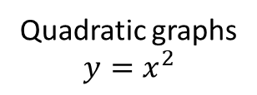

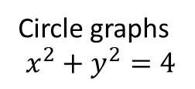

Year 10 Higher
TYPES OF GRAPH
Examples
Quadratic graphs
$$y=x^{2}$$
Reciprocal graphs
$$y=\frac{1}{x}$$
Circle graphs
$$x^{2}+y^{2}=4$$
Cubic graphs
$$y=x^{3}$$
Key Words
Quadratic
Cubic
Reciprocal
Circle
Graph
Match the graph with the correct equation:
$x^{2}+y^{2}=6$
$y=\frac{1}{x}$
$y=x^{3}−2$
$y=x^{2}+1$
b)
d)
257, 298-301, 314
a)
c)
ANSWERS: 1d 2b 3a 4c

Slide 3
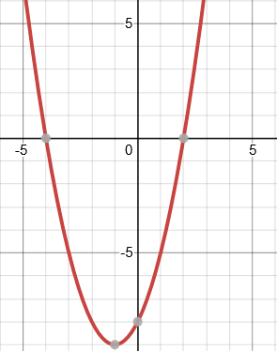
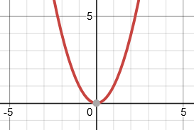
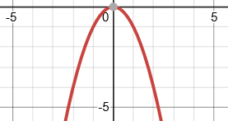
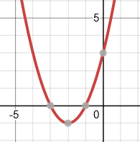








Year 10 Higher
QUADRATIC GRAPHS
Key Concepts
Line of symmetry
$$x=−1$$
Examples
A quadratic graph will always be in the shape of a parabola.
$$y=x^{2}+2x−8$$
$$y=x^{2}$$
$$y={−x}^{2}$$
A quadratic equation can be solved from its graph.
The roots of the graph tell us the possible solutions for the equation. There can be 1 root, 2 roots or no roots for a quadratic equation. This is dependant on how many times the graph crosses the x axis.
The roots of a quadratic graph are where the graph crosses the x axis. The roots are the solutions to the equation.
Roots $x=−4$
$x=2$
Turning point
$$(−1,−9)$$
y intercept = $−8$
Key Words
Quadratic
Roots
Intercept
Turning point
Line of symmetry
Identify from the graph of $y=x^{2}+4x+3$:
The line of symmetry
The turning point
The y intercept
The two roots of the equation
251-256
ANSWERS 1) $x=−2 2) (−2,−1) 3) 3 4) x=−1 and x=−3$

Slide 4
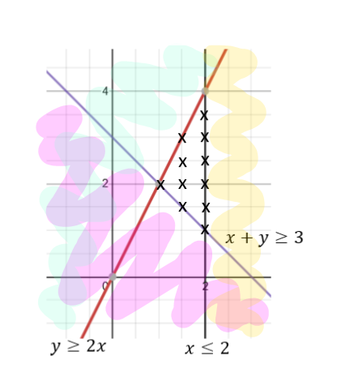
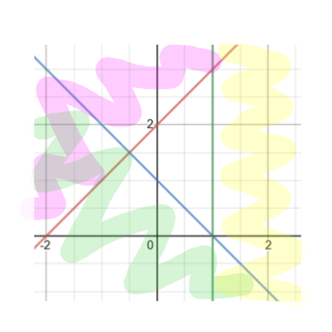





Year 10 Higher
INEQUALITIES AND REGIONS ON GRAPHS
Key Concepts
Examples
Inequalities can be represented on graphs. They highlight regions where all of the possible true values exist within its given constraints.
Solid lines are used on the graph when ≤ ≥ are involved.
Dashed lines are used on the graph when $<>$ are involved.
Highlight the region that represents the possible solutions to the following inequalities:
$$x≤2$$
$$y≤2x$$
$$x+y≥3$$
Plot the points for each linear graph and draw the lines.
Choose a coordinate whose values can be substituted in to each inequality. If the inequality is FALSE once values have been substituted in, then shade this area.
You should be left with one area with no shading once you have repeated this for all inequalities.
Each x is a possible set of integer values which are true for all three inequalities. Eg. (2,1), (2,2) (2,3)…
$$y ≤x+2$$
State the possible integer values that are true for the given inequalities.
Key Words
Region
Inequality
Solution
273-276
$$x≤1$$
$$y≥−x+1$$
ANSWER (1,0), (1,1), (1,2), (1,3), (0,1), (0,2)

Slide 5
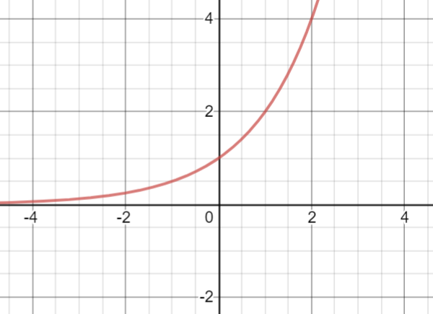
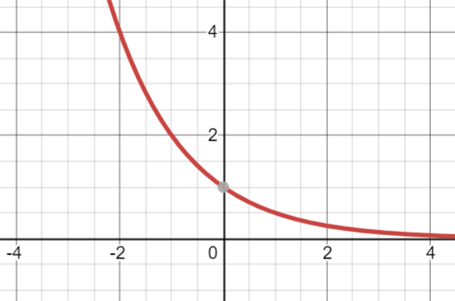
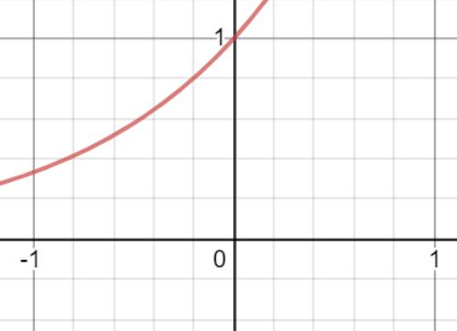


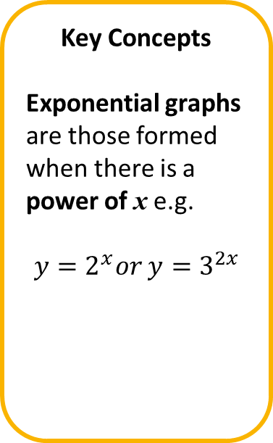

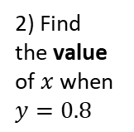

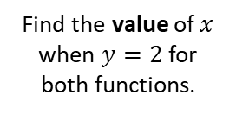


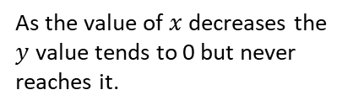

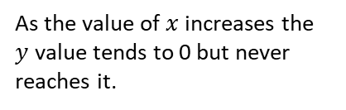
Year 11 Higher (Unit 2)
EXPONENTIAL GRAPHS
Key Concepts
Exponential graphs are those formed when there is a power of x e.g.
$$y=2^{x}or y=3^{2x}$$
Examples
$$y=2^{x}$$
$$y=2^{−x}$$
Find the value of$x$ when $y=2$ for both functions.
When $y=2$ , $x=1$
When $y=2$ , $x=−1$
As the value of $x$increases the $y$ value tends to infinity.
As the value of $x$decreases the $y$ value tends to infinity.
As the value of $x$decreases the $y$ value tends to 0 but never reaches it.
As the value of $x$increases the $y$ value tends to 0 but never reaches it.
Key Words
Exponential
Infinity
Function
Power
1) Complete the values in the table for $y=3^{x}$
2) Find the value of$x$ when $y=0.8$
x | 0 | 1 | 2 | 3
y
302
ANSWERS: 1a) 1, 3, 9, 27 2) $x$ = - 0.2

