Slide 1
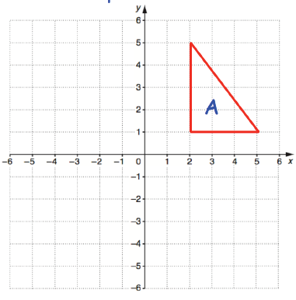
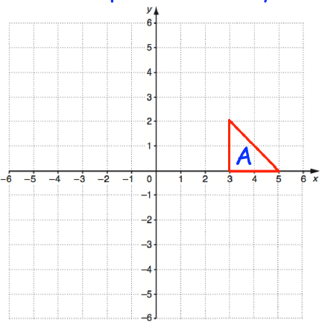
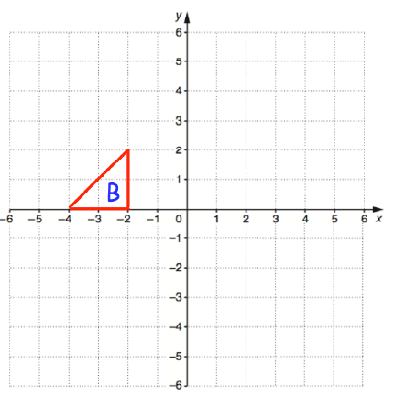



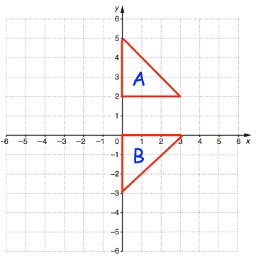
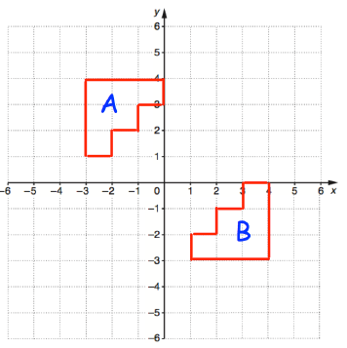
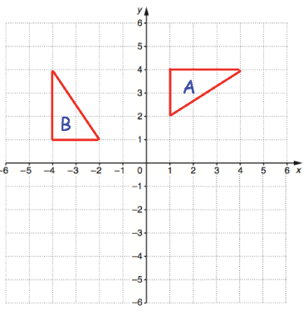
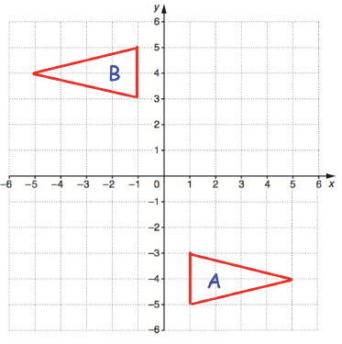

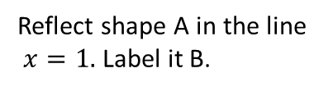
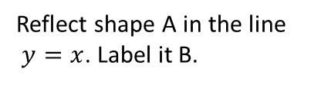


REFLECTION AND ROTATION
Key Concepts
Examples
A reflection creates a mirror image of a shape on a coordinate graph. The mirror line is given by an equation eg. $y=2, x=2,y=x.$The shape does not change in size.
Reflect shape A in the line $x=1.$ Label it B.
Reflect shape A in the line $y=x$. Label it B.
Rotate shape B from the point (-1, -2)
(-1,-2), clockwise, 90º. Label it C.
A rotation turns a shape on a coordinate grid from a given point. The shape does not change size but does change orientation.
B
B
C
x
Clockwise
Anticlockwise
$$x=1$$
$$y=x$$
Key Words
Rotate
Clockwise
Anticlockwise
Centre
Degrees
Reflect
Mirror image
Describe the single transformation you see on each coordinate grid from A to B:
639-641, 652, 653,654,648,649
ANSWERS: a) reflection, $y=1$ b) reflection$y=x$ c) rotation, centre (0,0), 90º anticlockwise
d) rotation, centre (0,0), 180º

Slide 2
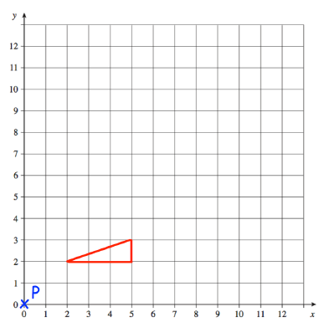
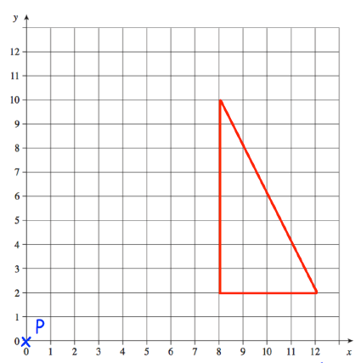
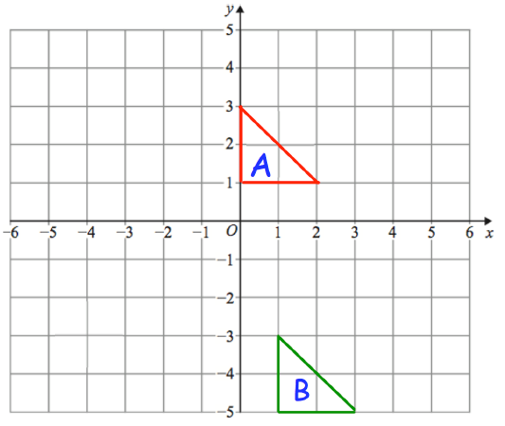
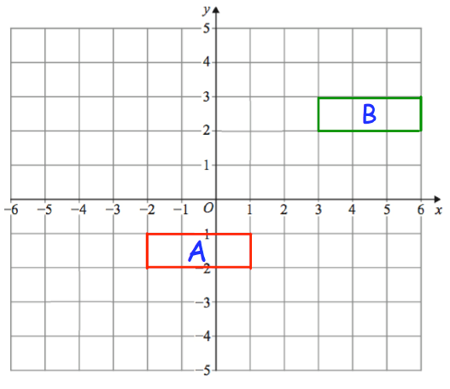
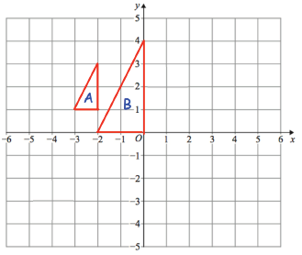
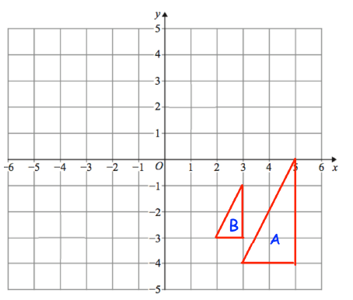
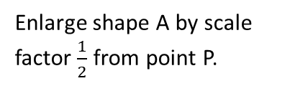
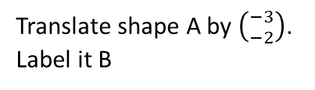

TRANSLATION AND ENLARGEMENT
Key Concepts
Examples
A translation moves a shape on a coordinate grid. Vectors are used to instruct the movement:
$$\left({x \atop y}\right)$$
Translate shape A by $\left({−3 \atop −2}\right)$. Label it B
Enlarge shape A by scale factor 2 from point P.
Enlarge shape A by scale factor $\frac{1}{2}$ from point P.
Positive-Right
Negative - Left
Positive-Up
Negative - Down
B
B
A
An enlargement changes the size of an image using a scale factor from a given point.
A
B
Key Words
Translation
Enlargement
Scale factor
Centre
Positive
Negative
Describe the single transformation you see on each coordinate grid from A to B:
637,638,650, 642-645, 651
ANSWERS: a) translation $\left({1 \atop −6}\right)$ b) translation $\left({5 \atop 4}\right)$ c) enlarge, centre (-4,2) scale factor 2 d) enlarge, centre (1,-2) scale factor $\frac{1}{2}$

