Slide 1
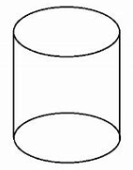
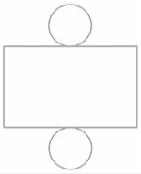





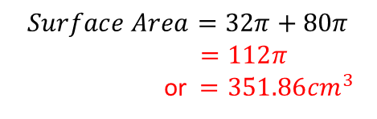



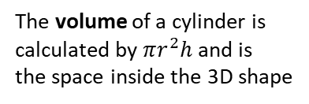


VOLUME AND SURFACE AREAS OF CYLINDERS
Key Concepts
Examples
From the diagram calculate:
A cylinder is a prism with the cross section of a circle.
b) Surface Area – You can use the net of the shape to help you
4cm
r
4cm
d
10cm
$$Area of two circles$$
$$=2×π×r^{2}$$
a) Volume
10cm
h
$$=2×π×4^{2}$$
The volume of a cylinder is
calculated by $πr^{2}h$ and is
the space inside the 3D shape
$$V= π×r^{2}×h$$
$$=32π$$
$$V= π×4^{2}×10$$
$$Area of rectangle$$
$$=π×d×h$$
$=π×8×10$
$$=80π$$
$$V=160π$$
$$Surface Area=32π+80π$$
$=112π$
or $=351.86{cm}^{3}$
The surface area of a cylinder is calculated by $2πr^{2}+πdh$ and is the total of the areas of all the faces on the shape.
Or $=502.65{cm}^{3}$
Key Words
Cylinder
Surface Area
Radius
Diameter
Pi
Volume
Prism
Calculate the volume and surface area of this cylinder
7cm
572, 586
15cm
ANSWERS: Volume = $735π$ or 2309.07cm³ Surface area = $308π$ or 967.61cm³

Slide 2
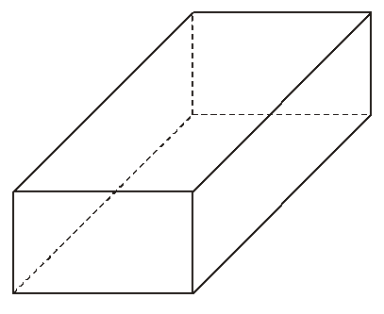
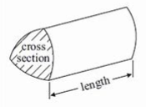
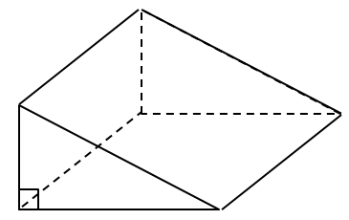
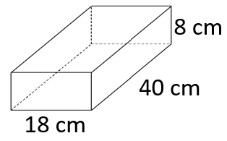
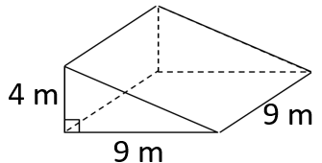









VOLUME AND SURFACE AREA OF PRISMS
Key Concept
Examples
$$Surface area:$$
$$Front=4×2=8$$
$$Back=4×2=8$$
$$Side 1=9×2=18$$
$$Side 2=9×2=18$$
$$Bottom=4×9=36$$
$$Top=4×9=36$$
$Total=126{cm}^{2}$
The volume of an object is the amount of space that it occupies. It is measured in units cubed e.g. cm³.
To calculate the volume of any prism we use:
2 cm
$$Volume=4×9×2$$
$$=72{cm}^{3}$$
9 cm
4 cm
$$×length$$
$$Area of triangle=\frac{5×7}{2}$$
$$Surface area:$$
$$Front=\frac{7×5}{2}=17.5$$
$$Back=\frac{7×5}{2}=17.5$$
$$Side =5×11=55$$
$$Bottom=7×11=77$$
$$Top=11×8.6=94.6$$
$Total=261.6{cm}^{2}$
$$=17.5{mm}^{2}$$
8.6 mm
A prism is a 3D shape which has a continuous cross-section.
$$Volume=17.5×11$$
The surface area of an object is the sum of all of its faces. It is measured in units squared e.g. cm².
$$=192.5{mm}^{3}$$
5 mm
11 mm
7 mm
568-571, 584-586
Key Words
Volume
Capacity
Prism
Surface area
Face
Find the volume and
surface area
of each of these prisms:
1)
2)
9.8m
ANSWERS: 1)Volume = 5760 cm³ Surface area = 2368 cm² 2) Volume = 162 m³ Surface area = 241.2m²

Slide 3
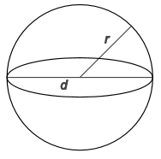
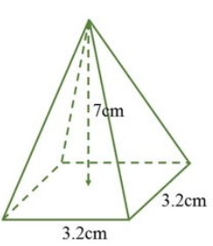
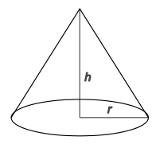
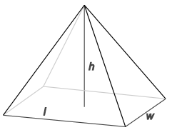
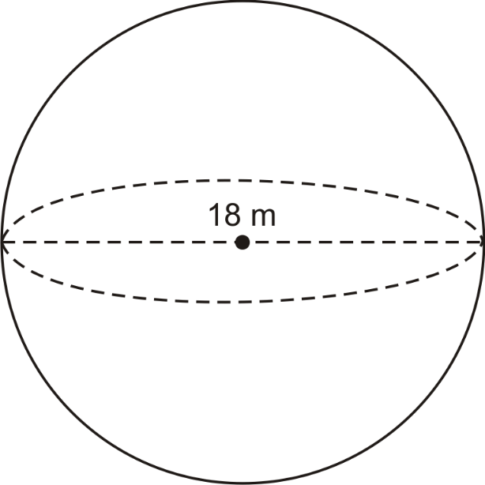
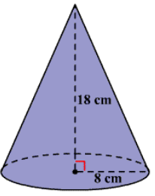
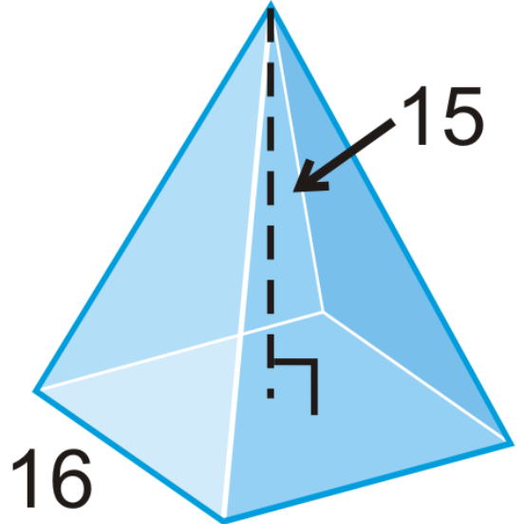



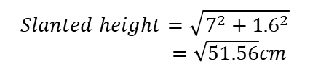





VOLUME AND SURFACE AREA OF CONES, SPHERES AND PYRAMIDS
Key Concepts
Examples
$$Volume of a pyramid=\frac{(3.2×3.2)×7}{3}$$
In your exam you will be given the following formulae to use:
$$Volume of a sphere= \frac{4}{3}πr^{3}$$
$$=23.89{cm}^{3}$$
$$Surface area=base+4 triangles$$
$$Surface area of a sphere=4πr^{2}$$
$$3.2×3.2=10.24{cm}^{2}$$
l
$$Volume of a cone= \frac{πr^{2}h}{3}$$
We will need to find the slanted height to be able to calculate the area of our triangles.
$$Surface area of a cone=πr^{2}+πrl$$
$$Area of 4 triangles=$$
$$4\left(\frac{3.2×\sqrt{51.56}}{2}\right)$$
$$=45.96{cm}^{2}$$
In your exam you will need to know the following formulae:
$$Slanted height=\sqrt{7^{2}+{1.6}^{2}}$$
$=\sqrt{51.56}cm$
$$Volume of a pyramid=\frac{base area×height}{3}$$
$$Surface area=10.24+45.96=56.20{cm}^{2}$$
Key Words
Surface Area
Volume
Sphere
Cone
Pyramid
Radius
Height
Slanted length
Calculate the volume and surface area of:
1) 2) 3)
576-579, 587
19.7cm
ANSWERS: 1) V = 3053.6cm³ SA = 1017.9cm² 2) V = 1206.4cm³ SA = 696.2cm² 3) V = 1280cm³ SA = 800cm²

