Slide 1
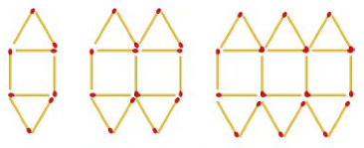



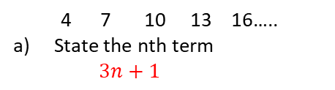

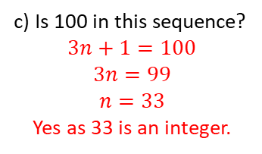


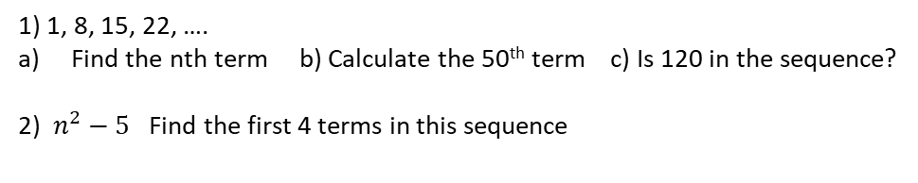

SEQUENCES
Key Concepts
Pattern 1
Pattern 2
Pattern 3
Examples
Linear/arithmetic sequence:
-3
+3
+3
+3
+3
Linear sequences with a picture:
Arithmetic or linear sequences
increase or decrease by a common amount each time.
Geometric series has a common multiple between each term.
Quadratic sequences include an $n^{2}.$ It has a common second difference.
Fibonacci sequences
are where you add the two previous terms to find the next term.
+1
4 7 10 13 16…..
State the nth term
$3n+1$
State the nth term.
Hint: Firstly write down the
number of matchsticks in
each image:
$7n+1$
Difference
The 0th term
Pattern 1 | Pattern 2 | Pattern 3
8 | 15 | 22
+1
b) What is the 100th term in the sequence?
$$3n+1$$
$$3×100+1=301$$
-7
+7
+7
Geometric sequence e.g.
×3
×3
×3
c) Is 100 in this sequence?
$$3n+1=100$$
$$3n=99$$
$$n=33$$
Yes as 33 is an integer.
4 12 36 108...
Quadratic sequence e.g. $n^{2}+4$ Find the first 3 numbers in the sequence
First term: $1^{2}+4=5$
Third term: $3^{2}+4=$13
Second term: $2^{2}+4=8$
Key Words
Linear
Arithmetic
Geometric
Sequence
Nth term
1) 1, 8, 15, 22, ….
Find the nth term b) Calculate the 50th term c) Is 120 in the sequence?
2) $n^{2}−5$ Find the first 4 terms in this sequence
,
198, 247-250, 264
ANSWERS: 1a) 7n – 6 b) 344 c) 18 so yes as n is an integer 2) -4, -1, 4, 11

