Slide 1
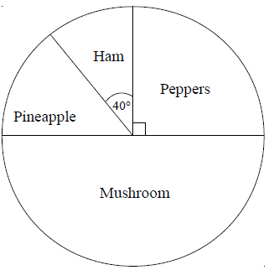
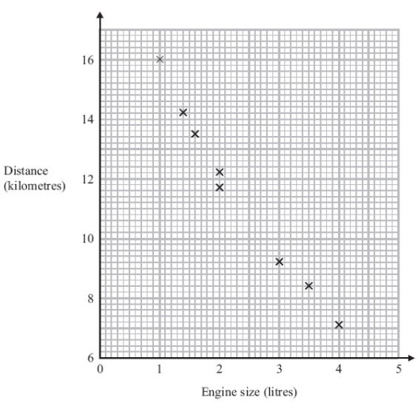
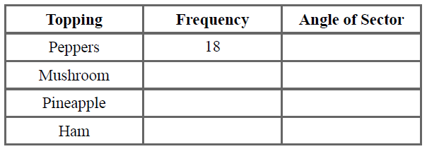
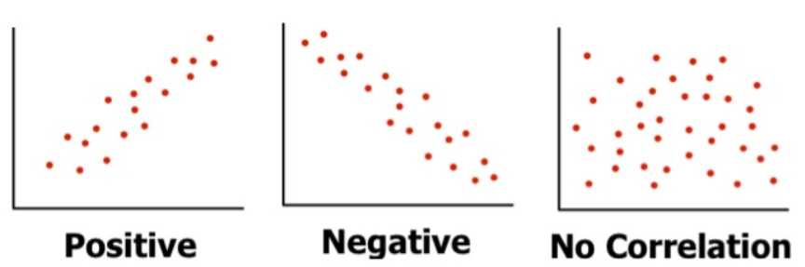

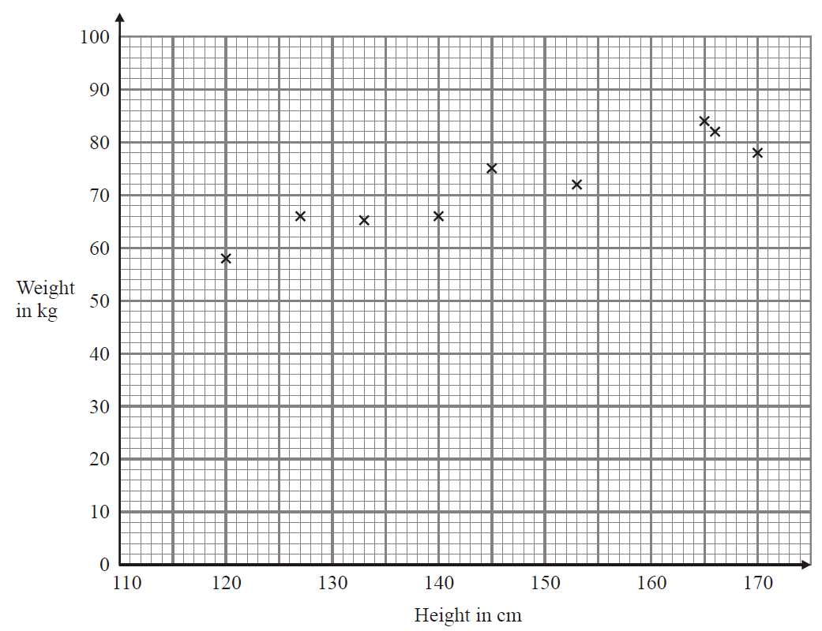
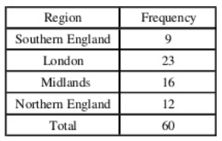
PIE CHARTS AND SCATTER-GRAPHS
Key Concepts
Examples
Pie charts use angles to represent, proportionally, the quantity of each group involved.
Pie charts can only be compared to one another when the total frequency or populations are given.
Scatter-graphs show the relationship between two variables. This relationship is called the correlation.
A scatter-graph is drawn to show the relationship between the engine size of a car and how far it can travel.
It shows negative correlation.
This is an outlier.
It does not match the trend.
We draw a line of best fit through the data points to help estimate readings, based on the data sample. For example, estimating the engine size of a car that can travel 11km would be
2.4 litres.
×
11km
90º
36
180º
10
50º
8
40º
2.4 l
Total=72
360º
360º ÷ 72
×5
Key Words
Pie chart
Scatter-graph
Correlation
Outlier
Variable
1) Calculate the angle for each category:
2a) What type of correlation is shown?
b) Using a line of best fit estimate the weight when the height is 135cm.
427-429, 453,454
ANSWERS: 1) 360º÷60=6º , Angles = 54º, 138º, 96º, 72º 2) a) positive b) 64kg-66kg

