Slide 1
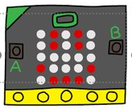
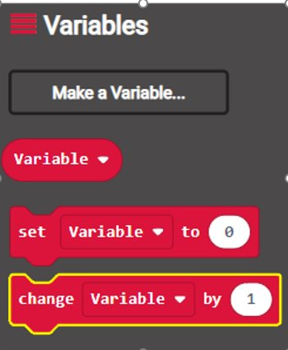
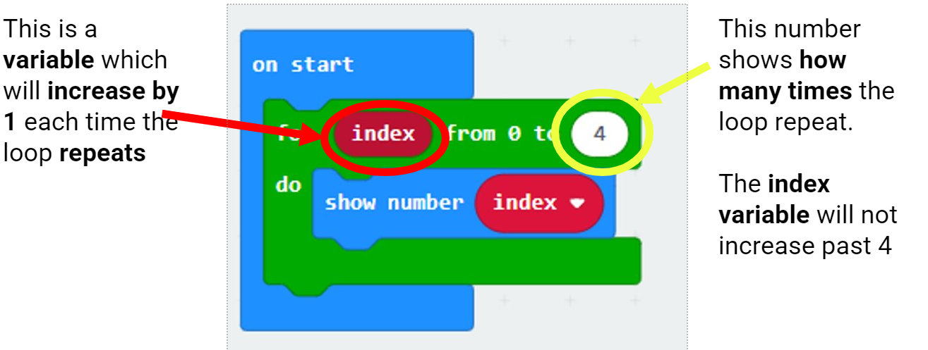
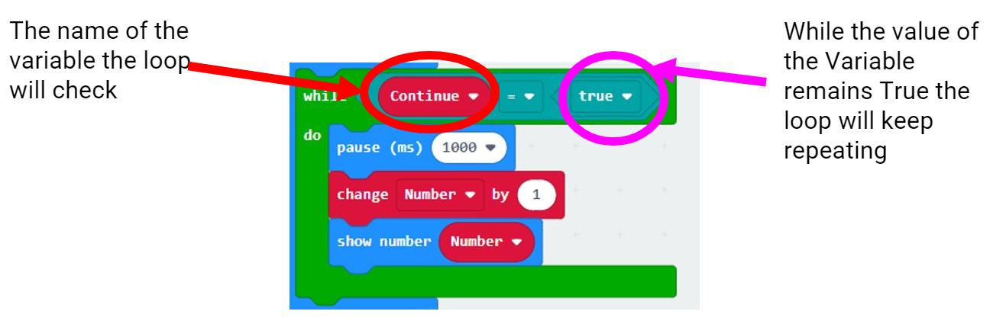
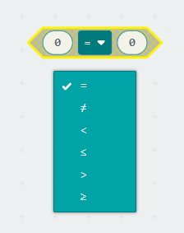
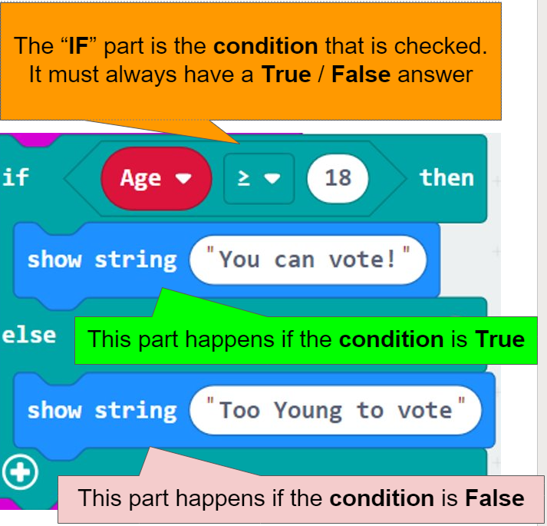
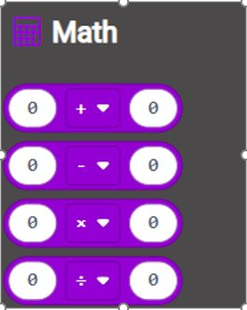
Knowledge Organiser: Micro:Bits
Variable = a container where data can stored in a program.
Variables can be changed throughout the running of the program.
Iteration = where we can program a section of code to repeat without needing to write it out multiple times.
There are two types of loops we can use For and While​.
Inputs = a device through which, energy or information enters a system.
Example: Keyboard.
This could be: A device used to put data onto the computer. For Micro:Bits this is Button A/B/A+B/Shake
Processor = “Brain of the computer”. Receives inputs, runs programs and gives outputs. Executes instructions in a program.
FOR LOOP
Constant = a container where data can stored in a program.
Constants cannot be changed throughout the running of the program.
Outputs = a place where power or information leaves a system.
Example: Monitor.
This could be: Speakers, headphones, projector or any device that shows the data on the computer. For Micro:Bits this is LED Lights
Accelerometer = A motion sensor that measures movement.
Example of use: When you turn your phone and the screen rotates.
Data Types:
1. String = Character datatype (can store a combination of letters, numbers and characters (!?£$).
2. Integer = Whole Number datatype (can only store whole numbers, no letters, characters or decimals allowed).
Comparison Operators can be used to check conditions in IF statements.
WHILE LOOP
Selection = we program a decision into our code which will then return a specific output.
IF statements are a form of selection. ​
Arithmetic Operators can change and alter the values of the variables in our programs.​
Sequencing = When the computer carries out instruction in order.

Slide 2

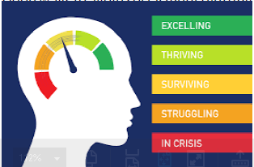
Knowledge Organiser: E-safety
What is E-safety? E-Safety is all about staying safe when you're using computers. You will be taught what dangers there are, how to avoid/prevent them, and what to do if things do go wrong. E | Think You Know? Fake News/Fake Profiles. It is very easy for someone to set up a fake profile online or create/share fake news. Social Media companies and E-mail providers don't ask for ID when accounts are created. This means you can never be 100% sure who you are talking to. If someone you only know online asks to meet up, always take a trusted adult with you or don't meet them. If someone asks for personal information or images, block them! | Social Media and Mental Health Social Media Websites let you exchange information with groups of people on the internet. Your mental health is how happy you feel, over a period of time. Lots of material on social media is filtered or exaggerated to make posts look more exciting. If your feeds are full of this material, it can make you feel like you're missing out or that your life isn't as good as other peoples. This can be bad for your mental health. In reality, everyone has good and bad days, we tend to post more of the happy, exciting things online. Good ways to avoid social media getting you down are: Be aware it's not the whole story. Reduce time spent online. Spend more time with offline friends. Exercise and develop offline interests.
Hackers and Malware Hackers are people who access computers without the owner’s permission. Using strong passwords that are hard to guess can help protect you. An example of a strong password is: E-461hu@ - it used upper and lower case, symbols and numbers, and it has no personal significance. Other advice includes not using the same password in multiple places. Malware – Software that tries to steal your information or damage your computers. Common types include: Viruses, spyware, ransomware. To protect from Malware you should use firewalls, anti-malware software (such as anti-virus) and don’t click on links sent to you from people you don’t know. | Digital Footprints Your digital footprint is everything the internet knows about you. The internet is a collection of computers all connected together. Information stored on the internet is easy to search but difficult to remove. It is important because any information about you online could be used by employers or colleges to judge you. To protect your digital footprint, keep social media accounts private and only add people that you really know. You should also search for yourself every so often to see what information about you is easily accessible by anyone. Personal information is information about you, e.g. name, address, gender.

