Slide 1
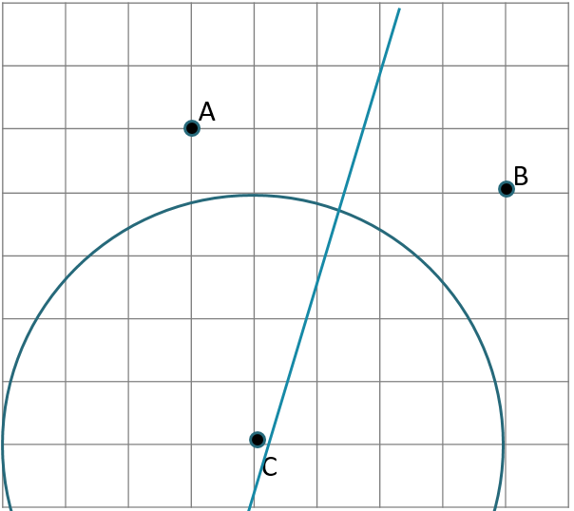
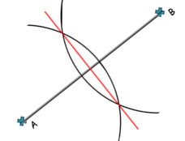
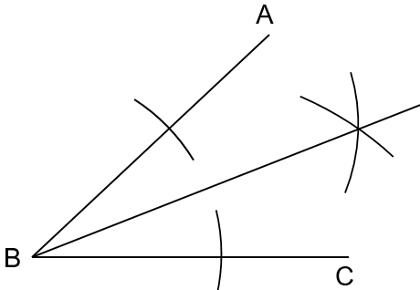
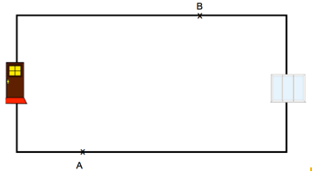

CONSTRUCTIONS AND LOCI
Key Concepts
Examples
Line bisector
Shade the region that is:
- closer to A than B
- less than 4 cm from C
Line bisector
of A and B
Circle with radius 4cm
Angle bisector
0
Key Words
Bisect
Radius
Region
Shade
There are two burglar alarm sensors, one at A and one at B.
The range of each sensor is 4m.
The alarm is switched on.
Is it possible to walk from the front door to the patio door without setting off the alarm?
683,660-665,
674-679
1cm = 1m

