Slide 1
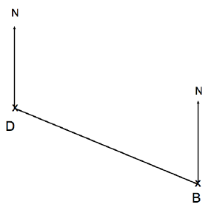
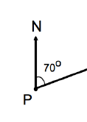

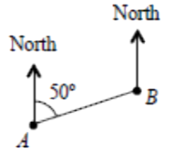
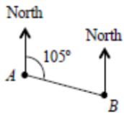
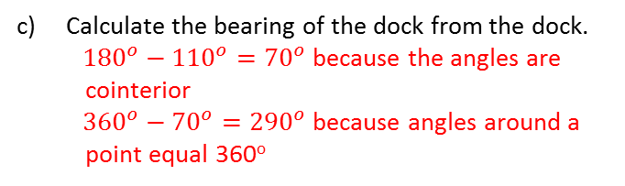

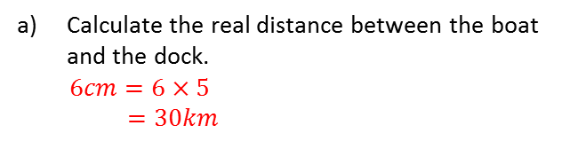
SCALES AND BEARINGS
Key Concepts
Examples
Scales are used to reduce real world dimensions to a useable size.
The diagram shows the position of a boat B and dock D.
Calculate the real distance between the boat and the dock.
$6cm=6×5$
$=30km$
A bearing is an angle, measured clockwise from the north direction. It is given as a 3 digit number.
b) State the bearing of the boat from the dock.
${110}^{o}$
110º
c) Calculate the bearing of the dock from the dock.
${180}^{o}−{110}^{o}={70}^{o}$ because the angles are cointerior
${360}^{o}−{70}^{o}={290}^{o}$ because angles around a point equal 360º
70º
0
290º
The scale of the diagram is 1cm to 5km.
Key Words
Scale
Bearing
Clockwise
North
Find the bearing of A from B
(Diagrams not drawn to scale):
a)
b)
674-679,492-495
Links
Geography
ANSWERS: (a) 230º (b) 285º

