Slide 1

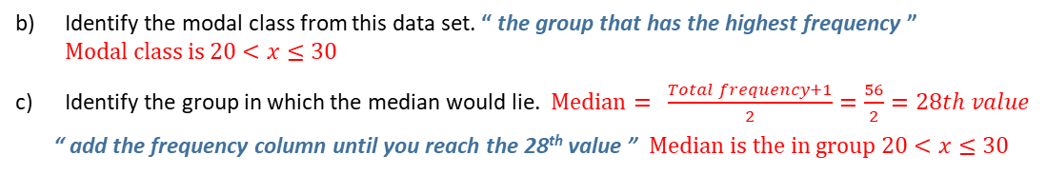

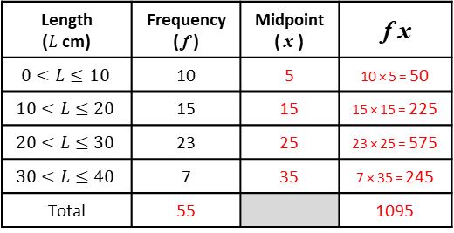


AVERAGES FROM A TABLE
Key Concepts
Examples
Modal class (mode)
Group with the highest frequency.
Median group
The median lies in the group which holds the $\frac{total frequency+1}{2}$ position.
Once identified, use the cumulative frequency to identify which group the median belongs from the table.
Estimate the mean
For grouped data, the mean can only be an estimate as we do not know the exact values in each group. To estimate, we use the midpoints of each group and to calculate the mean we find $\frac{total fx}{total f}$ .
Length ($L$ cm) | Frequency ( f ) | Midpoint ( x ) | f x
$$0<L≤10$$ | 10 | 5 | 10 × 5 = 50
$$10<L≤20$$ | 15 | 15 | 15 × 15 = 225
$$20<L≤30$$ | 23 | 25 | 23 × 25 = 575
$$30<L≤40$$ | 7 | 35 | 7 × 35 = 245
Total | 55 |  | 1095
Estimate the mean of this data.
step 1: calculate the total frequency
step 2: find the midpoint of each group
step 3: calculate $f$ × $x$
step 4: calculate the mean shown below
$\frac{Total fx}{Total f}=\frac{1095}{55}=19.9$cm
Identify the modal class from this data set. “ the group that has the highest frequency ”
$Modal class is 20<x≤30$
Identify the group in which the median would lie. $Median= \frac{Total frequency+1}{2}=\frac{56}{2}=28th value$
“ add the frequency column until you reach the 28th value ” $Median is the in group 20<x≤30$
Key Words
Midpoint
Mean
Median
Modal
Cost (£$C$)
$$0<C≤4$$
$$4<C≤8$$
$$8<C≤12$$
$$12<C≤16$$
$$16<C≤20$$
Frequency
2
3
5
12
3
Midpoint
From the data:
Identify the modal class.
Identify the group which holds the median.
Estimate the mean.
414-418
ANSWERS: a) $12<C≤16$ b) $\frac{25+1}{2}=$ 13th value is in the group $12<C≤16$ c) $\frac{294}{25}=£11.76$

