Slide 1

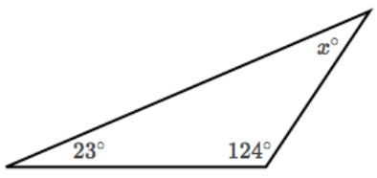
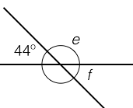
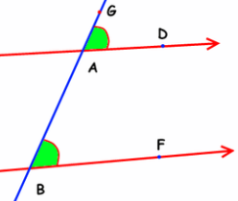
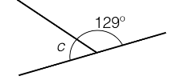
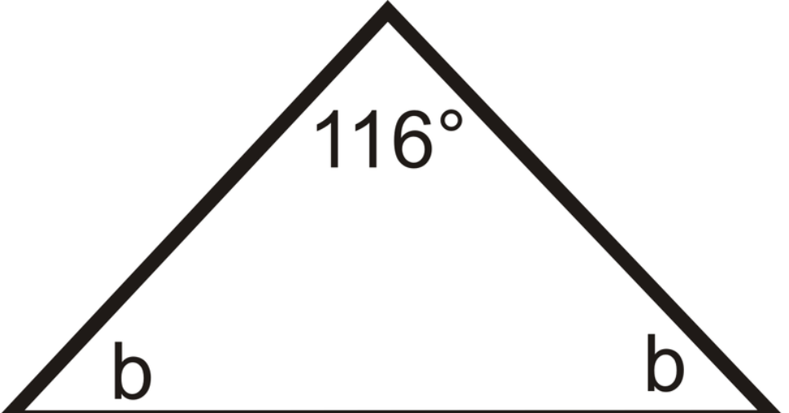
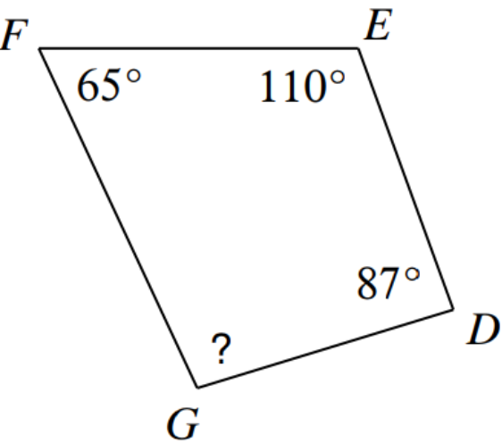


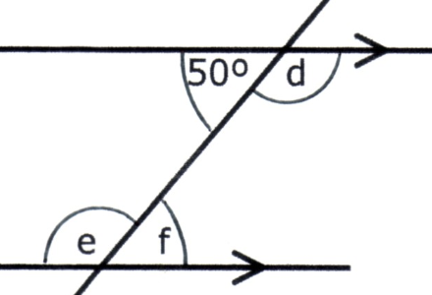
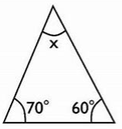
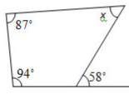





ANGLE FACTS INCLUDING ON PARALLEL LINES
Key Concepts
Angles in a triangle equal 180º.
Angles in a quadrilateral equal 360º.
Vertically opposite angles are equal in size.
Angles on a straight line equal 180º.
Base angles in an isosceles triangle are equal.
Alternate angles are equal in size.
Corresponding angles are equal in size.
Allied/co-interior angles are equal 180º.
Examples
$$x=180−\left(23+124\right)$$
$$x= {33}^{o}$$
Alternate angles are equal
$$f={44}^{o}$$
Corresponding angles are equal
$$c=180−129$$
$$x= {51}^{o}$$
Allied/co-interior angles equal 180º
$$b=(180−116)÷2$$
$$b= {32}^{o}$$
? $=360−\left(65+110+87\right)$
$$?= {98}^{o}$$
Questions
Key Words
Angle
Vertically opposite
Straight line
Alternate
Corresponding
Allied
Co-interior
a) b) c)
Calculate the missing angle:
477-480, 481-483
c
a
b
ANSWERS: 1) a=50º 2) b=122º c=57º 3) d=130º e=130º f=50º

